Slide 1
An Overview of ILL/DD Services of the NDL
Satoshi MATSUI
Public Services Division
Kansai-kan of the National Diet Library, Japan
Notes:
Thank you, Mr/Ms.XXX, for your kind introduction.
Good evening, I am Satoshi Matsui of the National Diet Library.
The NDL provides various international services including Reference Services and the online services on the NDL website.
Today, I’d like to talk about Photoduplication Service and International Loan Service.
I plan to speak for about five minutes.

Slide 2
Today’s Topic
General Information of ILL/DD Services
How to Make a Request
About Copying Service and Copyright
“For Japanese Studies” in the NDL Website
Notes:
In my presentation today, I’d like to talk about four topics.
Firstly, I will speak about a brief introduction to our ILL/DD services.
Then, I will describe How to Make a Request for Photoduplication and International Loan.
Thirdly, I will talk about Copyright of Japan.
Lastly, I will introduce “For Japanese Studies” in the NDL Website.

Slide 3
1. General Information of ILL/DD Services
Notes:
All right then, let’s move onto the main subject of the presentation.
First of all, I’d like to start by outlining our ILL/DD Services.

Slide 4
General Information on ILL/DD services
Photoduplication Service
User Registration is required
Copy Method: Photocopy or Microfilm printing
Shipping Method: Postal Mail only
Interlibrary Loan Service
“User Registration for ILL” is required
Not all NDL materials are loanable
Read only in a reading room of the library
Notes:
The point that I should pay attention is shown on the table.
Copies are sent by airmail.
In Interlibrary Loan Service, “User Registration for ILL” is required.
The items must be read only in a reading room of the requesting library.

Slide 5
Materials for ILL/DD services
Photoduplication Service
✓ |  | Holdings of the NDL
 | X | Residential maps
 | X | Electronic publications
 | X | Audio-visual materials
 | X | Damaged materials
X |  | Electronic Resources
 | ✓ | China Academic Journal Full-text Databases
Interlibrary Loan Service
✓ | Books
X | Periodicals
X | Original materials to have been digitized
X | Damaged materials
“Guidelines on Borrowing Restrictions” (Japanese only) http://www.ndl.go.jp/jp/library/handbook/info/limited_list.pdf
Notes:
Except for certain types of materials shown here, all materials held by the NDL are available for photoduplication.
Generally speaking, the materials that the NDL lends out are Japanese and Western books.
Please refer to the “Guidelines on Borrowing Restrictions.”

Slide 6
2. How to Make a Request
Notes:
Now, I’d like to move on to the next topic.

Slide 7
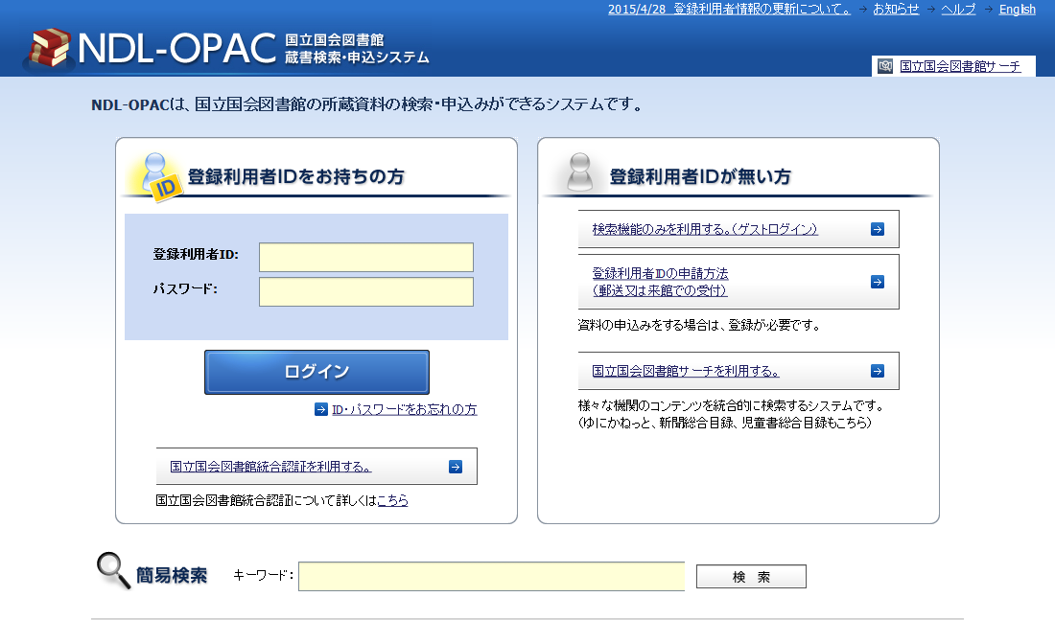
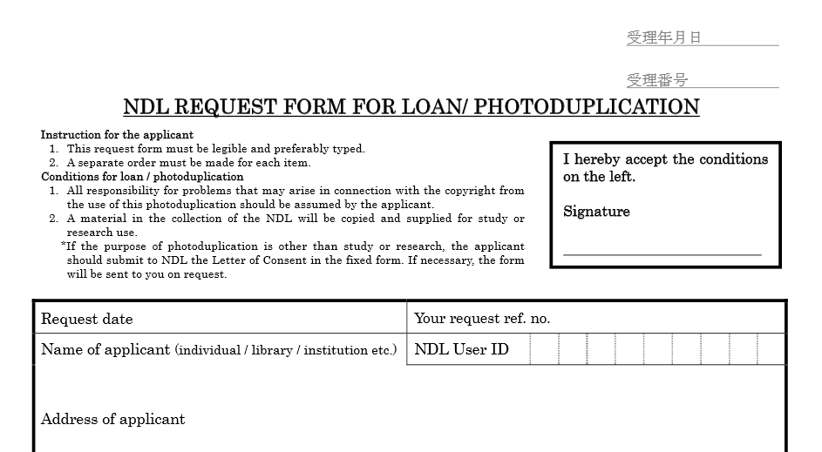
How to Make a Request
Japanese version of the NDL-OPAC
http://ndlopac.ndl.go.jp/
By fax or Postal mail
Request form
http://www.ndl.go.jp/en/service/NDL_Request_Form.pdf
Notes:
As you know, We currently accept orders via the Japanese version of the NDL-OPAC as well as by fax or postal mail.

Slide 8
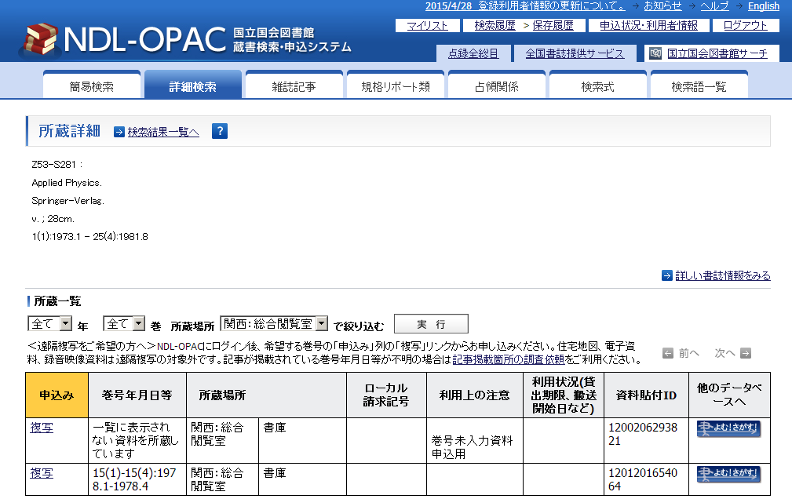
Tips: In case that volume numbers are not shown in the list
Choose “一覧に表示されない資料を所蔵しています”
Notes:
Here is complicated points to order.
When volume numbers are not shown in the list, apply from items shown as: 「一覧に表示されない資料を所蔵しています」. (Items not shown in the list are available.)

Slide 9
Tips: For copies of digitized magazines
Select "デジタルデータ" (Digital data), and click "実行" (Go).
Click "複写" (Photoduplication).
Notes:
For copies of digitized magazines:
Issues from one hundred nine to six hundred eighty two can’t be copied from original material.
In this case, Select "デジタルデータ" (Digital data), and click "実行" (Go).
After that, Click "複写" (Photoduplication) to proceed to the next step.

Slide 10
Tips: The National Diet Library Digital Collections are linked to the NDL-OPAC
All tables of contents are searchable as text.
Link to the NDL-OPAC .
Notes:
The National Diet Library Digital Collections are linked to the NDL-OPAC.
After clicking 書誌ID (Bibliographic ID), the same bibliographic record used in the NDL-OPAC appears.
All tables of content from digitized materials are searchable as text, regardless of whether or not the digitized images are available on the Internet.

Slide 11
E-Learning program about Photoduplication Requests
“How to request from overseas copies of NDL materials”
With English subtitles
Launched on March 22, 2016
“Training Programs for Librarians”
http://training.ndl.go.jp/index.html?lang=en
Thank you for your cooperation!
Notes:
I will introduce an E-Learning program from the NDL about our Photoduplication Service.
On March twenty two, We launched “How to request from overseas copies of NDL materials”.
NCC made English subtitles.
We are thankful to you for your cooperation.

Slide 12
3. About Copying Service and Copyright
Notes:
Up to here, I have spoken about our services. Now let me move on to Copying Service and Copyright.

Slide 13
Copyright
Generally, permission of the copyright holder is required.
An exception is granted to libraries.
Term of protection of copyrights
Ordinarily, 50 years following the death of the author.
If the copyright holder is an organization, 50 years following the publication of the work.
Notes:
Under Japan’s Copyright law, permission of the copyright holder is required to copy a work.
An exception to this rules is granted to libraries.
Term of protection of copyrights is as follows.
Ordinarily, for a period of fifty years following the death of the author.
If the copyright holder is an organization, fifty years following the publication of the work.

Slide 14
Limits on copying materials
“a part of a work”
In general, this means no more than 50 percent.
serial publications
Articles may be copied in their entirety, except for the most current issue of a magazine or newspaper.
The last issue of a serial publication can’t be copied generally.
“Information about Copyright (Japanese only)”
http://www.ndl.go.jp/jp/service/copy/copyright.html
Notes:
In general, the term "a part of a work" is interpreted to mean no more than fifty.
About serial publications:
Articles in any issue of a magazine or newspaper except the most current one may be copied in their entirety.
The last issue of a serial publication cannot be copied unless a considerable period of time has passed since publication.

Slide 15
FAQ
Rather than by mail, I would like copied material sent to me via email as a PDF. Or can you send it to me via fax?
Can you seek permission from copyright owners on behalf of me?
Notes:
I will answer frequently asked questions about copying services and copyright.
Rather than by mail, I would like copied material sent to me via email as a PDF. Or can you send it to me via fax?
In accordance with copyright laws, libraries must obtain permission from the copyright holder in order to send copyrighted materials either in electronic PDF form or by FAX or email. Therefore we cannot deliver copies in those formats.
Can you seek permission from copyright owners on behalf of me?
We don’t seek permission from copyright owners on behalf of users, and do not collect copyright royalties to provide its copying service.

Slide 16
4. For Japanese Studies on the NDL website
Notes:
Let’s move onto the last topic.
We provide services in support of Japanese studies worldwide.

Slide 17
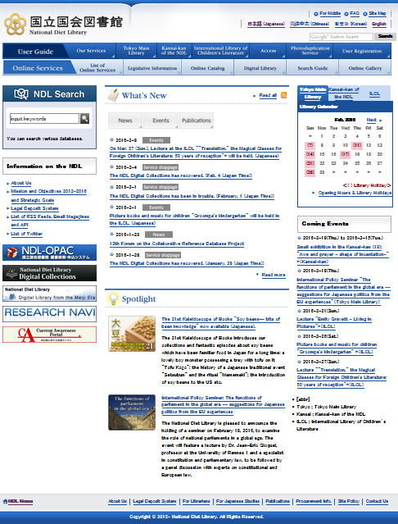
NDL is ready to support you!
“For Japanese Studies”
http://www.ndl.go.jp/en/japanesestudies/index.html
Providing link to various information beneficial for Japanese Studies Librarians
For example:
search guides (Research Navi)
bibliographic information,
training programs,
other related institutions, etc.
The link is at the BOTTOM of the top page!
Notes:
The page “For Japanese Studies” is a web portal on the NDL website, where you can find links to a variety of information that is useful to Japanese Studies librarians.
For example, there are links to remote services as ILL/DD and reference, search guides (Research Navi), bibliographic information, training programs and other related institutions, etc.

Slide 18
NDL is ready to support you!
“National Diet Library Newsletter” http://www.ndl.go.jp/en/publication/ndl_newsletter/index.html
Carries articles introducing NDL’s collections, events, etc.
For example:
“Materials available in the Modern Japanese Political History Materials Room”
http://www.ndl.go.jp/en/publication/ndl_newsletter/200/20002.html
http://www.ndl.go.jp/en/publication/ndl_newsletter/201/20102.html
“Guide to finding an author's year of death”
http://www.ndl.go.jp/en/publication/ndl_newsletter/201/20104.html
Notes:
“National Diet Library Newsletter” is a bimonthly newsletter which carries general information and reports on NDL activities.
If you are searching for information on modern Japanese history, see:
“Materials available in the Modern Japanese Political History Materials Room.”
If you would like to know whether the copyright of a Japanese work has expired or not, see:
“Guide to finding an author's year of death.”

Slide 19
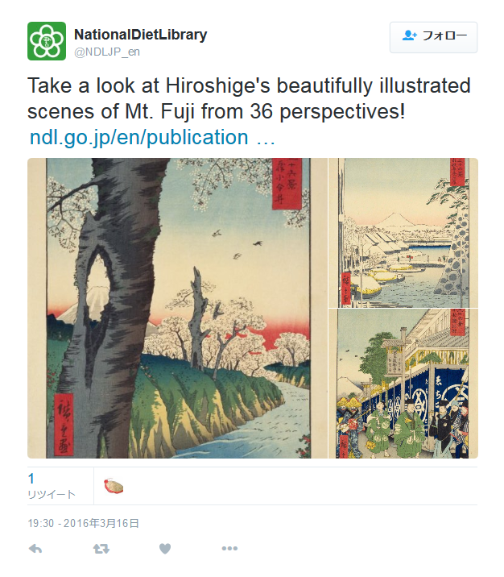
NDL is ready to support you!
The NDL launched an English Twitter account this March ! https://twitter.com/ndljp_en
Notes:
On March fifteen, we launched an English Twitter account.
Please follow us on Twitter for lots of useful information in English.

Slide 20
Thank you very much for your kind attention!
Notes:
I’d like to close my presentation.
Thank you very much for your attention.

