Slide 1
"From Passive Reception to Active Promotion ​"​
Constructing the International Leiden Asian Library and the Digital Future of Japanese Special Collections

Slide 2
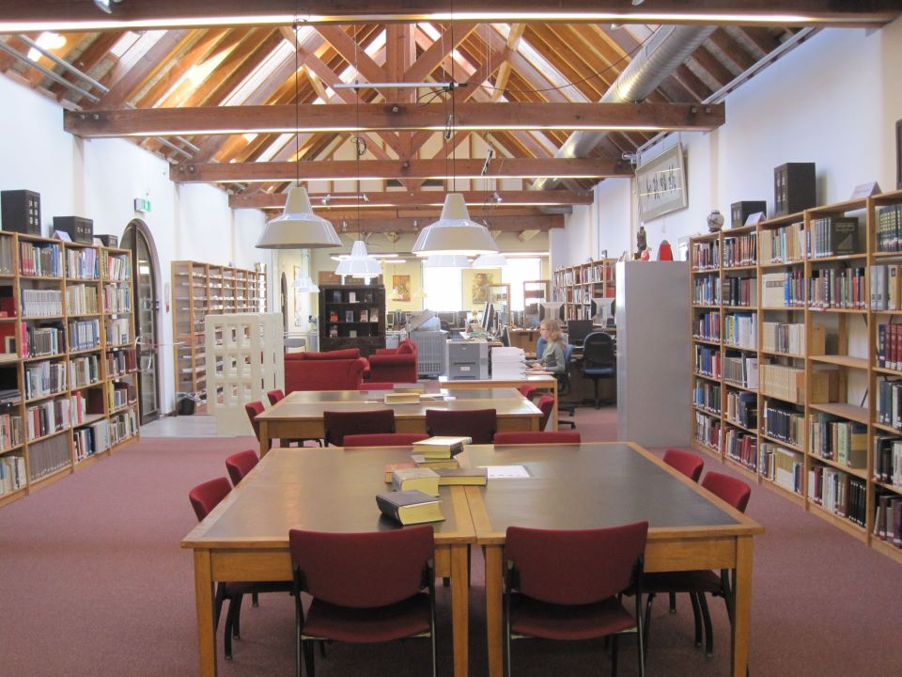
The East Asian Library
‘The Rebel Library’?
Modern collections vs. Special Collections
Users of the collections

Slide 3
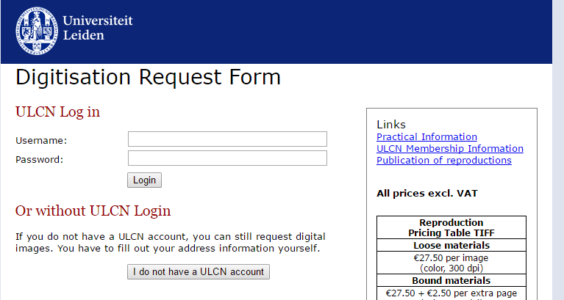
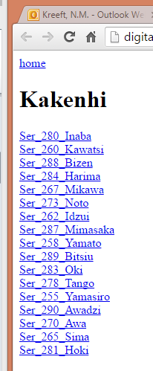
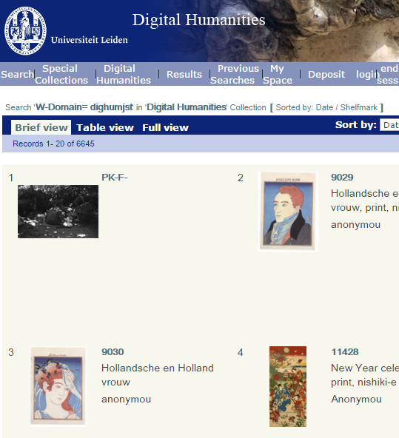
Digitization so far
Passive Digitization
Japanese maps
Requests by patrons
Image ‘hijack’
Availability
The digitool mess
Temporary storage

Slide 4
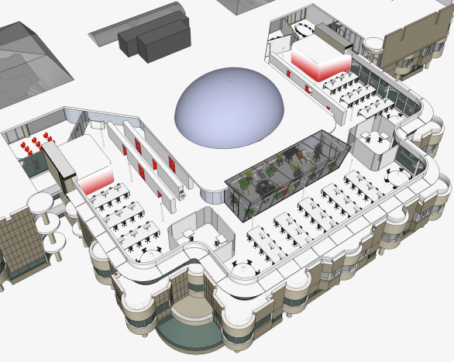
The Asian Library (2017)
2009 – merger of EAL
2014-2016: backlog cataloguing project
2016 (summer) – merger of collections
2017 (spring) New Reading Room
2017(September) Formal opening ‘Asian Library’

Slide 5
Digital Humanities developments (general)
2 assistant professors Digital Humanities
2 digital humanities librarians
Center for Digital scholarship
New Digital Image Repository and Infrastructure

Slide 6
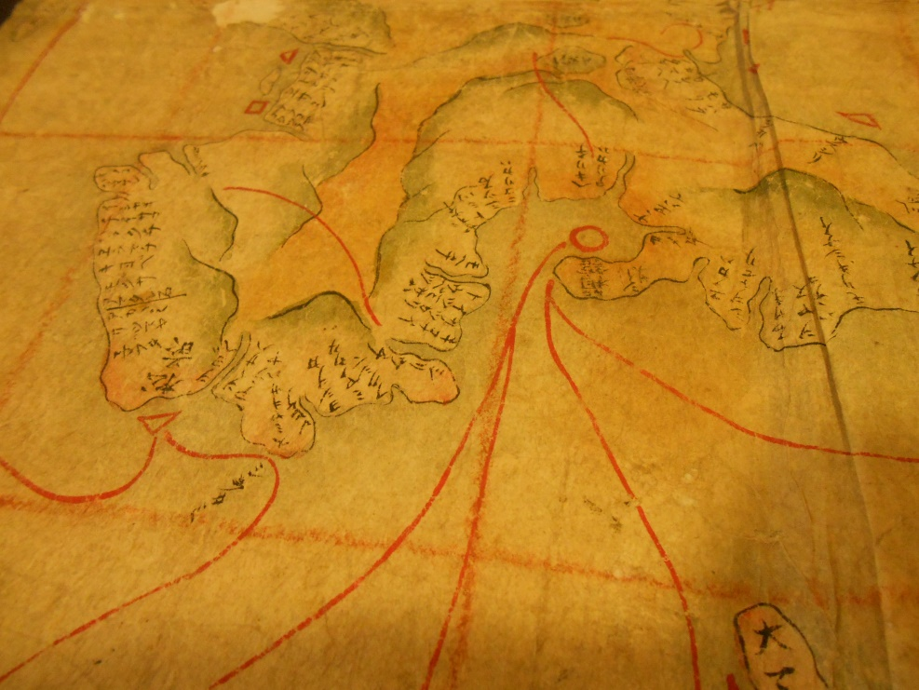
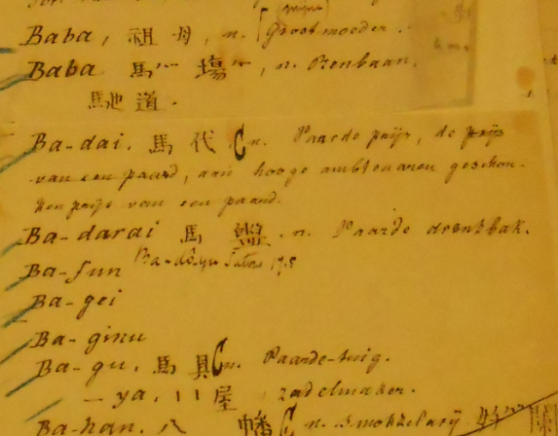
Digital Humanities for Japanese collections (2016-2020)
Siebold Collections
‘forbidden maps’
Plants and animal drawings
Hoffmann collections
Manuscript dictionaries
Language studies (chin, jap)
Letters and correspondence

Slide 7
Digital Humanities: Not just ‘scan ‘n dump’
Distinctive opening page for individual collections
Georeferencing maps
Active involvement scholars
Adding Metadata in MARC21 records
Example: North Korean Propaganda Poster project (Leiden 2015-2017)

Slide 8
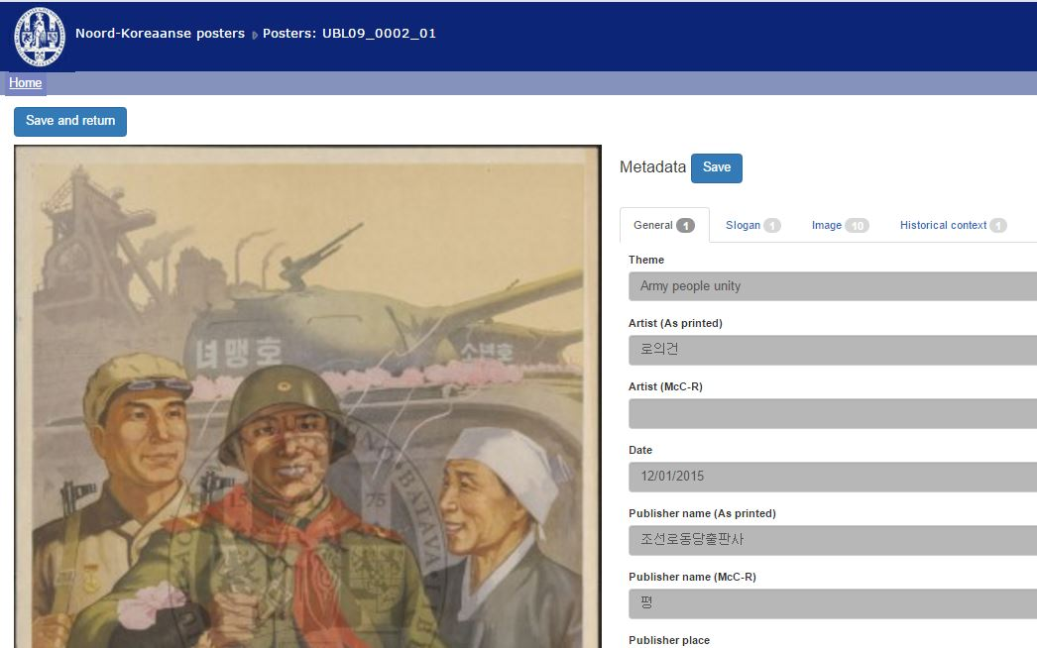
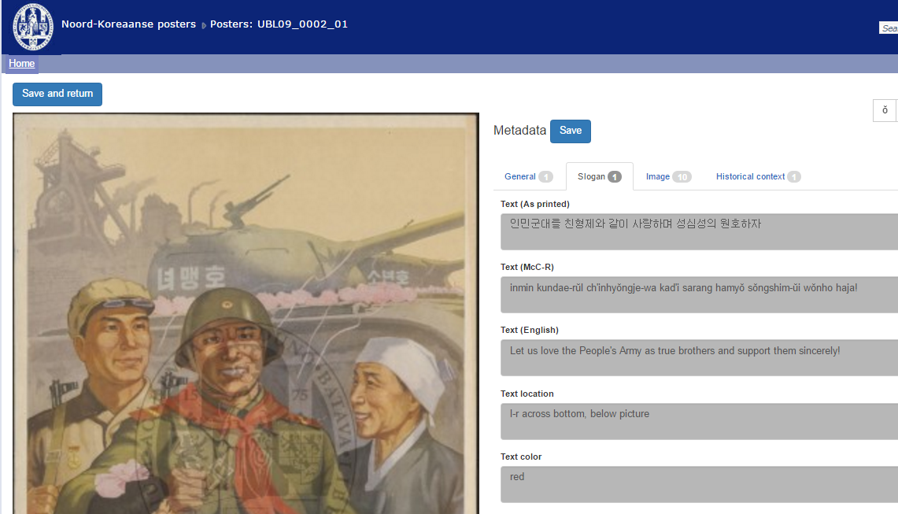
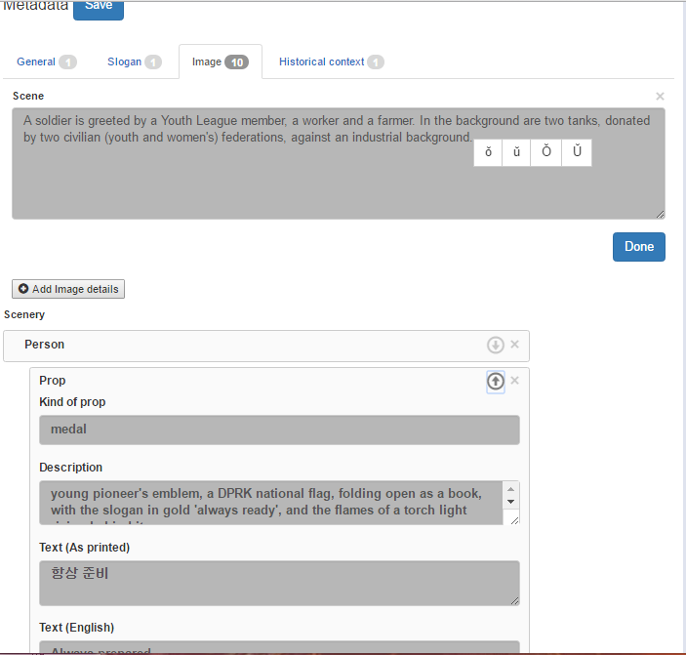

Slide 9
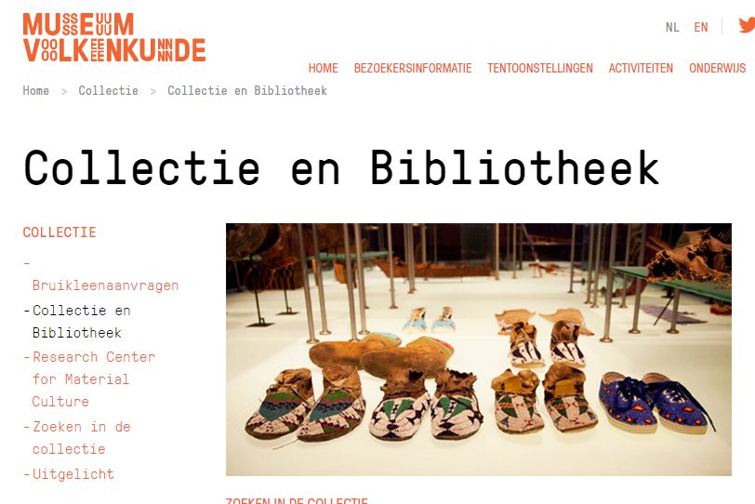
Digital Humanities for Japanese collections: beyond 2020
Hoffmann collections beyond physical boundaries
Siebold collections beyond borders
Scholar Crowdsourcing for Rangaku materials

Slide 10
Challenges for Libraries and Librarians
The ‘Birth Rate’ of new digital databases for Japanese studies
‘The Void’ – a turnoff for institutions?
The ‘Baby Save plan’
Guide to Japanese Digital Collections
Team effort of librarians worldwide
Crowdsourcing

Slide 11
Conclusion
Japanese Digitization projects in Leiden: from passive reception to active promotion
‘Avoid the Void’: Cooperation and coordination for the LibGuide 2.0 in Japanese studies.
Joining scattered collections online and visibility of collections as an incentive for institutions to go digital.

Slide 12
Thank you for your attention

